Slide 1
Introduction to Text Mining in Educational Research
Neo Qiang Hao
Learning, Design and Technology & Computer Science
University of Georgia
Stephanie Panke
University of North Carolina at Chapel Hill
Notes:
It’s my honor to run this workshop with Dr. Branch, and see so many famous scholars here. I’ve heard names of many of urs before, but didn’t get a chance to meet you until now. We do have contents that can be taught for longer than 3 hours. I’ll skip sth, and stress sth else, to try my best to meet your expectations.
The most valuable resources for educational researchers to take advantage of is text actually. We can’t make much use of images for large scale data analysis, unless it becomes important for us to teach a machine to tell the difference between human faces and cat faces. Therefore, we will talk more on text mining. If we have more time, we can extend to data mining.
What is text mining? It’s more of a method that can answer questions. We can start reviewing some questions outside educational fields and well answered by text mining.

Slide 2
Workshop Starter
www.socrative.com
Student login
MMHPCJBC3

Slide 3

Download Software
home.tobeneo.com/edutextmining
R
R Studio
Weka

Slide 4
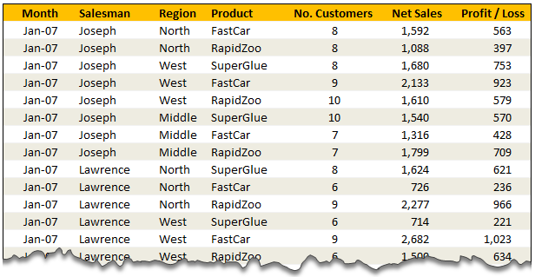
Data Mining

Slide 5
Text Mining
Problems:
Prediction / Classification
Is the coming email a spam?
Qualitative Understanding
What is the attitude of people on Twitter towards the presidential candidate Donald Trump?

Slide 6
Text Mining
Document 1: ……
Document 2: ……
Document 3: ……
“THAI TRADE DEFICIT WIDENS IN FIRST QUARTER Thailand's trade deficit widened to 4.5billion baht in the first quarter of 1987 from 2.1 billion year ago, the Business Economics Department said. It said Janunary/March imports rose to 65.1 billion bahtfrom 58.7 billion. Thailand's improved business climate this year resulted in a 27 pct increase in imports of raw material sand semi-finished products. The country's oil import bill, however, fell 23 pct in the first quarter due to lower oil prices.”

Slide 7
Text Mining
A dog bites a man.
A man bites a dog.

Slide 8
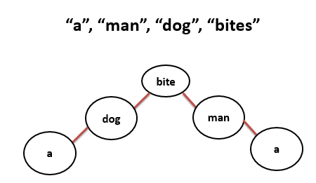
Text Mining
Occam's razor:
Among competing hypotheses, the one with the fewest assumptions should be selected.

Slide 9
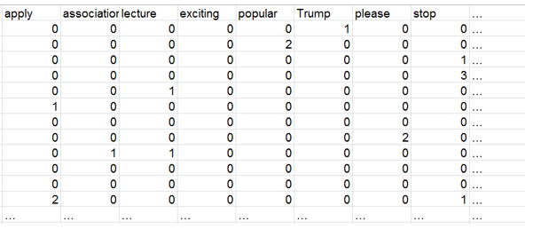
Text Mining

Slide 10
Text Mining
Tf-IDF (www.tfidf.com)
TF-IDF = TF * IDF
TF = (Number of times term t appears in a document) / (Total number of terms in the document)
IDF = log_e(Total number of documents / Number of documents with term t in it)

Slide 11
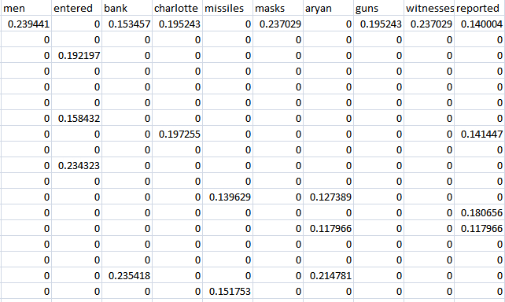
Text Mining

Slide 12

Questions Answered by Text Mining
Is the coming email a spam?

Slide 13
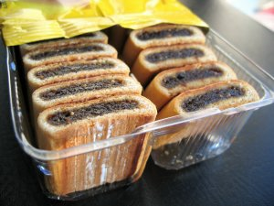
Questions Answered by Text Mining
What aspects do the product reviews for Fig Newtons on Amazon cover?

Slide 14

Questions to Answer by Text Mining in Education
What letter score should be given to this essay automatically?

Slide 15

Questions to Answer by Text Mining in Education
Is that a question relevant to learning?
Is that question an effective learning question?

Slide 16
Research Methods
Supervised Learning
Logistics Regression
Support Vector Machine
Decision Tree
……
Unsupervised Learning
Clustering analysis
Manifold learning
……

Slide 17






Tools

Slide 18
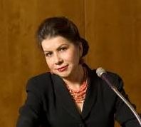
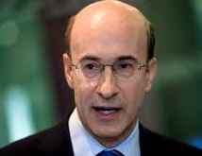


Tools
Carmen Reinhart
Kenneth Rogoff
Thomas Herndon

Slide 19





Tools

Slide 20
Research Pipeline
Data Collection
Data Cleaning
Data Analysis
Sharing Data and Results
Data Processing

Slide 21
Research Pipeline
Data Collection
Data Cleaning
Data Analysis
Sharing Data and Results
Data Processing

Slide 22
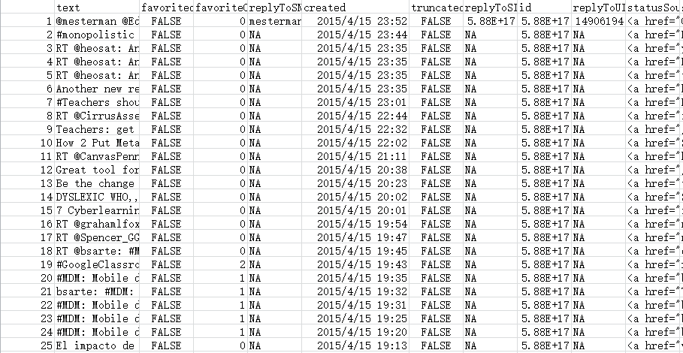
Data Cleaning

Slide 23
Data Cleaning

Slide 24

Data Cleaning
Regular Expression
madam, baad, dad, gooffoog

Slide 25
Data Cleaning
Regular Expression
reg <- "([a-zA-Z0-9]+://)?([a-zA-Z0-9_]+:[a-zA-Z0-9_]+@)?([a-zA-Z0-9.-]+\\.[A-Za-z]{2,4})(:[0-9]+)?(/.*)?«

Slide 26
Data Cleaning
Regular Expression
reg <- "([a-zA-Z0-9]+://)?([a-zA-Z0-9_]+:[a-zA-Z0-9_]+@)?([a-zA-Z0-9.-]+\\.[A-Za-z]{2,4})(:[0-9]+)?(/.*)?«
www.regular-expressions.info

Slide 27
Research Pipeline
Data Collection
Data Cleaning
Data Analysis
Sharing Data and Results
Data Processing

Slide 28
Data Processing
Basic Procedures:

Slide 29
Data Processing
Basic Procedures:
Remove punctuation

Slide 30
Data Processing
Basic Procedures:
Remove punctuation
Remove other non-characters

Slide 31
Data Processing
Basic Procedures:
Remove punctuation
Remove other non-characters
!@#$%^&*()_+-~|\/<>

Slide 32
Data Processing
Basic Procedures:
Remove punctuation
Remove other non-characters
Remove stop words

Slide 33
Data Processing
Basic Procedures:
Remove punctuation
Remove other non-characters
Remove stop words
a, an, the, he, him, I, me, …

Slide 34
Data Processing
Basic Procedures:
Remove punctuation
Remove other non-characters
Remove stop words
Lowercases

Slide 35
Data Processing
Basic Procedures:
Remove punctuation
Remove other non-characters
Remove stop words
Lowercases
Stem

Slide 36
Data Processing
Basic Procedures:
Remove punctuation
Remove other non-characters
Remove stop words
Lowercases
Stem
play
played

Slide 37
Data Processing
Basic Procedures:
Remove punctuation
Remove other non-characters
Remove stop words
Lowercases
Stem
do
does
did

Slide 38
Data Processing
Basic Procedures:
Remove punctuation
Remove other non-characters
Remove stop words
Lowercases
Stem
go
goes
went

Slide 39
Data Processing
Basic Procedures:
Remove punctuation
Remove other non-characters
Remove stop words
Lowercases
Stem
lie
lay
laid

Slide 40
Research Pipeline
Data Collection
Data Cleaning
Data Analysis
Sharing Data and Results
Data Processing

Slide 41

Data Analysis
An Introduction to Statistical Learning with Application in R

Slide 42

Data Analysis
Data Mining: Practical Machine Learning Tools and Techniques

Slide 43
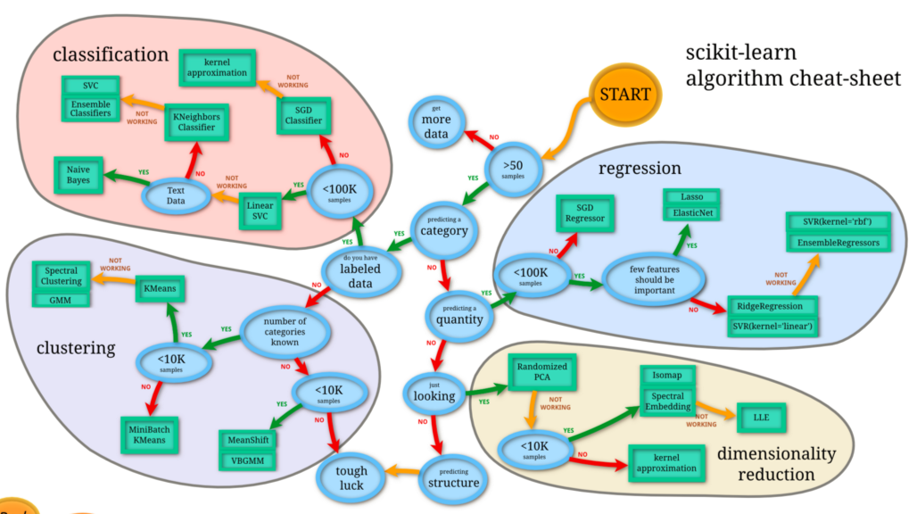
Data Analysis

Slide 44
Data Analysis
Supervised Learning
Naïve Bayes Multinomial
Support Vector Machine
……
Unsupervised Learning
Clustering Analysis
……

Slide 45
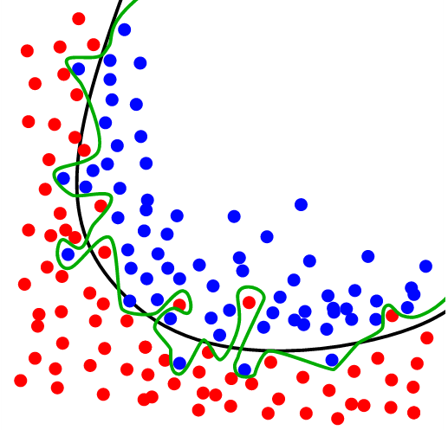
Data Analysis
Overfitting

Slide 46
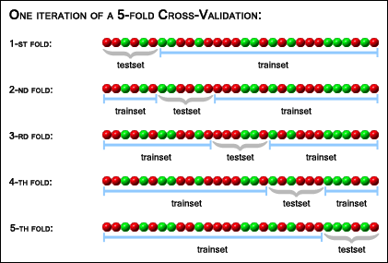
Data Analysis
Cross-validation

Slide 47

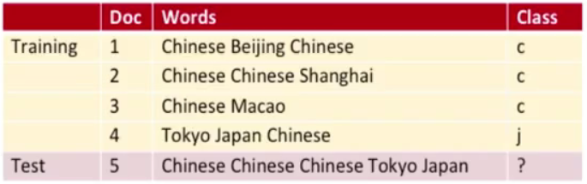
Data Analysis
Naïve Bayes Multinomial

Slide 48


Data Analysis

Slide 49
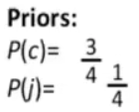
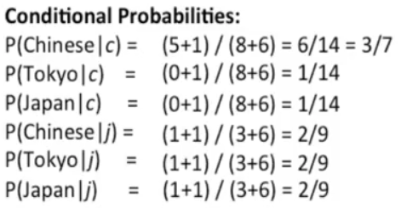
Data Analysis

Slide 50
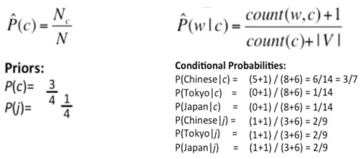
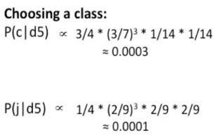
Data Analysis

Slide 51
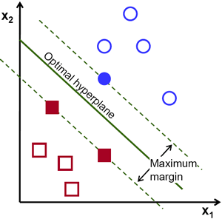
Data Analysis
Support Vector Machine

Slide 52
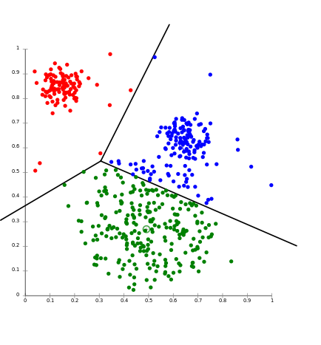
Data Analysis
Cluster Analysis

Slide 53
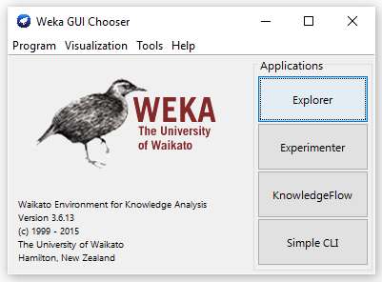
Data Analysis

Slide 54
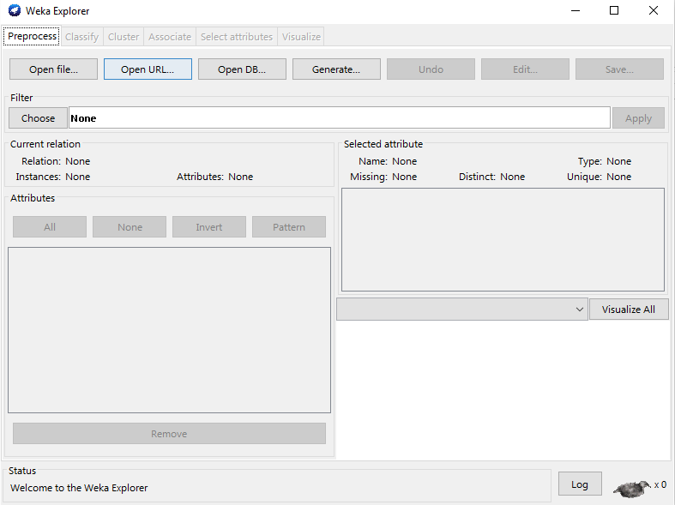
Data Analysis

Slide 55
Research Pipeline
Data Collection
Data Cleaning
Data Analysis
Sharing Data and Results
Data Processing

Slide 56

Sharing Data and Results
Git + GitHub
Git: https://git-scm.com/downloads
https://github.com/Neo-Hao
KnitR + Rpubs
Example: rpubs.com/neohao/online-help-seeking

Slide 57
Research Pipeline
Data Collection
Data Cleaning
Data Analysis
Sharing Data and Results
Data Processing

Slide 58
Data Collection
Discussion Forums or Q&A Platforms
Facebook
Twitter
Static Pages

Slide 59

Data Collection
http://www.reginfo.gov/public/do/eAgendaViewRule?pubId=200210&RIN=1125-AA38

Slide 60
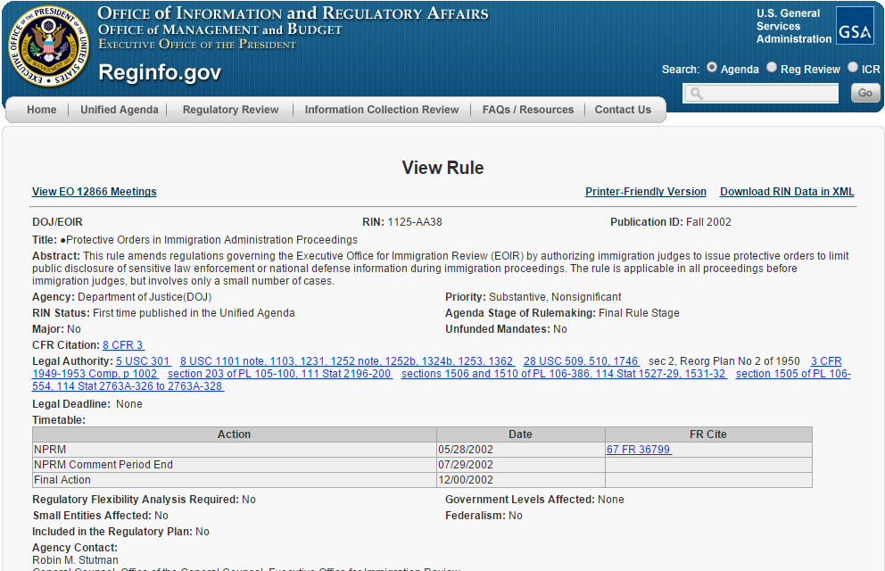
Data Collection

Slide 61

Data Collection
http://www.reginfo.gov/public/do/eAgendaViewRule?pubId=200210&RIN=1125-AA38

Slide 62
Data Collection
https://github.com/Neo-Hao/Web-Scraping-from-USGSA

Slide 63
Data Collection
http://www.reginfo.gov/public/do/eAgendaViewRule?pubId=200210&RIN=1125-AA38

Slide 64

Data Collection
Scrapping data form static web pages:
A good understanding of HTML & CSS
A good understanding of XML & JSON

Slide 65
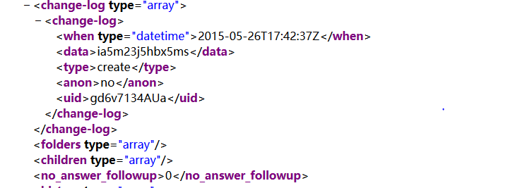
Data Collection
XML

Slide 66
Data Collection
XML

Slide 67
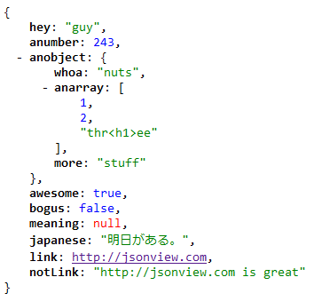
Data Collection
JSON

Slide 68
Data Collection
JSON

Slide 69
Data Collection
Scrapping data form static web pages:
A good understanding of HTML & CSS
A good understanding of XML & JSON

Slide 70
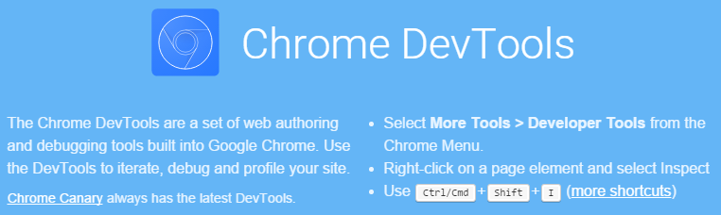
Data Collection
Scrapping data form static web pages:
A good understanding of HTML & CSS
A good understanding of XML & JSON
Familiar with Development Tools of Browsers

Slide 71
Data Collection
Scrapping data form static web pages:
A good understanding of HTML & CSS
A good understanding of XML & JSON
Familiar with Development Tools of Browsers
Familiar with R and package “XML”

Slide 72
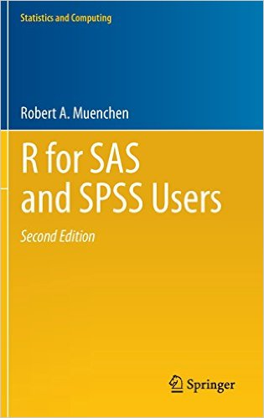
Data Collection
R for SAS and SPSS Users
Google r xml package filetype:pdf

Slide 73

Data Collection
R in a Nutshell

Slide 74

Data Collection
getwd()
setwd(“C:/Users/John/Analysis”)
setwd(“/home/Analysis”)
setwd(“XXX/TwitterHashtagR/data”)

Slide 75

Data Collection
Authentication
Register your own app
Keep your consumer keys and secrets
Go to Data Collection/Authentication.R
Replace consumer keys and secrets with yours
Run lines 1-42

Slide 76
Data Collection
Collect User Info
Go to Data Collection/collectUsers.R
Run lines 1-33

Slide 77
Data Collection
Collect User Info
Go to Data Collection/collectUsers.R
Run lines 1-33
Practice: Find 5 twitter accounts that you would like to collect information about, and collect their basic information in a .csv file

Slide 78
Data Collection
Collect tweets of particular users
Go to Data Collection/getTweetsByUser.R
Run lines 1-24

Slide 79
Data Collection
Collect tweets of particular users
Go to Data Collection/getTweetsByAllUser.R
Run lines 1-68
Note: Make sure you have a file named “three_conferences.csv” in the current directory.

Slide 80
Data Collection
Collect tweets of particular users
Go to Data Collection/getTweetsByAllUser.R
Run lines 1-68
Practice: Get tweets from 2 different twitter accounts

Slide 81
Data Collection
Collect tweets by Hashtag
Go to Data Collection/hashtagSearch.R
Run lines 1-22

Slide 82
Data Collection
Collect tweets by Hashtag
Go to Data Collection/hashtagSearch.R
Run lines 1-22
Practice: Get tweets with one hashtag you like

Slide 83
Thanks!
neohao@uga.edu

